Slide 1

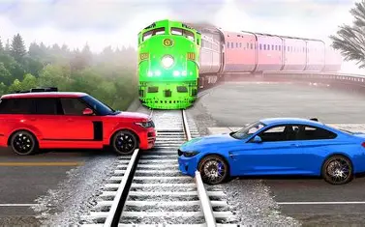
Prediction of Traffic Accident with Machine Learning

Slide 2

Agenda
Background & Objective
Dataset: EDA and Preprocessing
Machine Learning Model
  Histogram-based Gradient Boosting Classification Tree
  Logistic Regression
  Random Forest
Comparison
Challenges
Demonstration
Conclusion

Slide 3
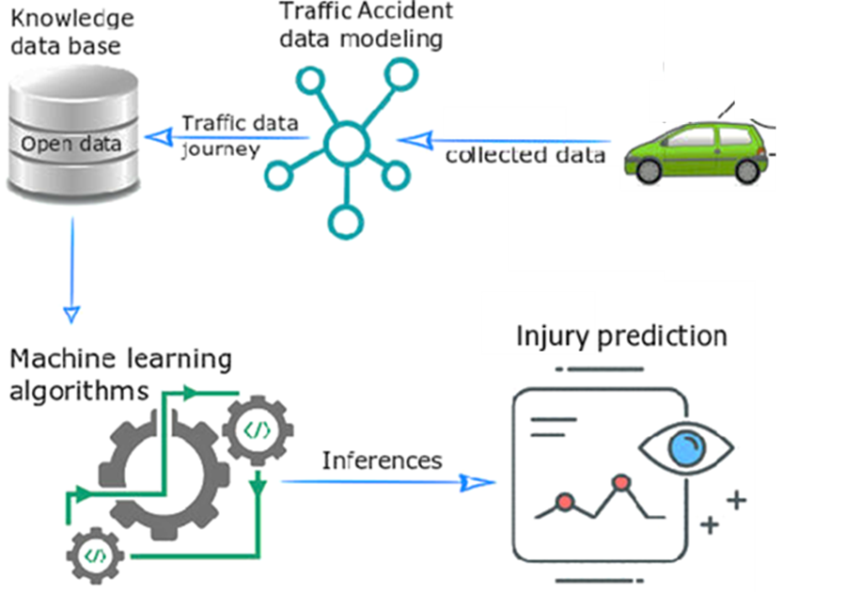
Background & Objective
Practising machine learning (ML) with data analysis on traffic accident
Comparing the performance of ML models
Applying the model to predict real-life scenario: risk of injury on a road

Slide 4


Introduction of Dataset
Data source from Kaggle:
https://www.kaggle.com/datasets/oktayrdeki/traffic-accidents
Data Volume:
200,000+ values * 24 columns
General Description:
Road conditions (e.g. defects, wet, …)
Traffic control (e.g. light, sign…)
Landscape (e.g. curve, straight…)
Weather (e.g. rain, snow…)
Injuries (e.g. fatal, incapacitating, no injuries…)
Damage
Date

Slide 5
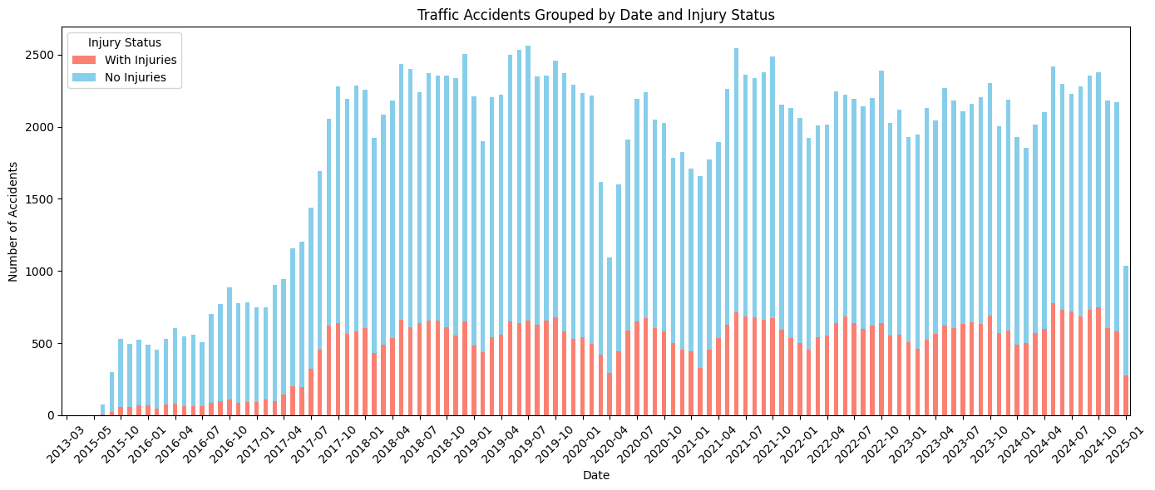
EDA

Slide 6
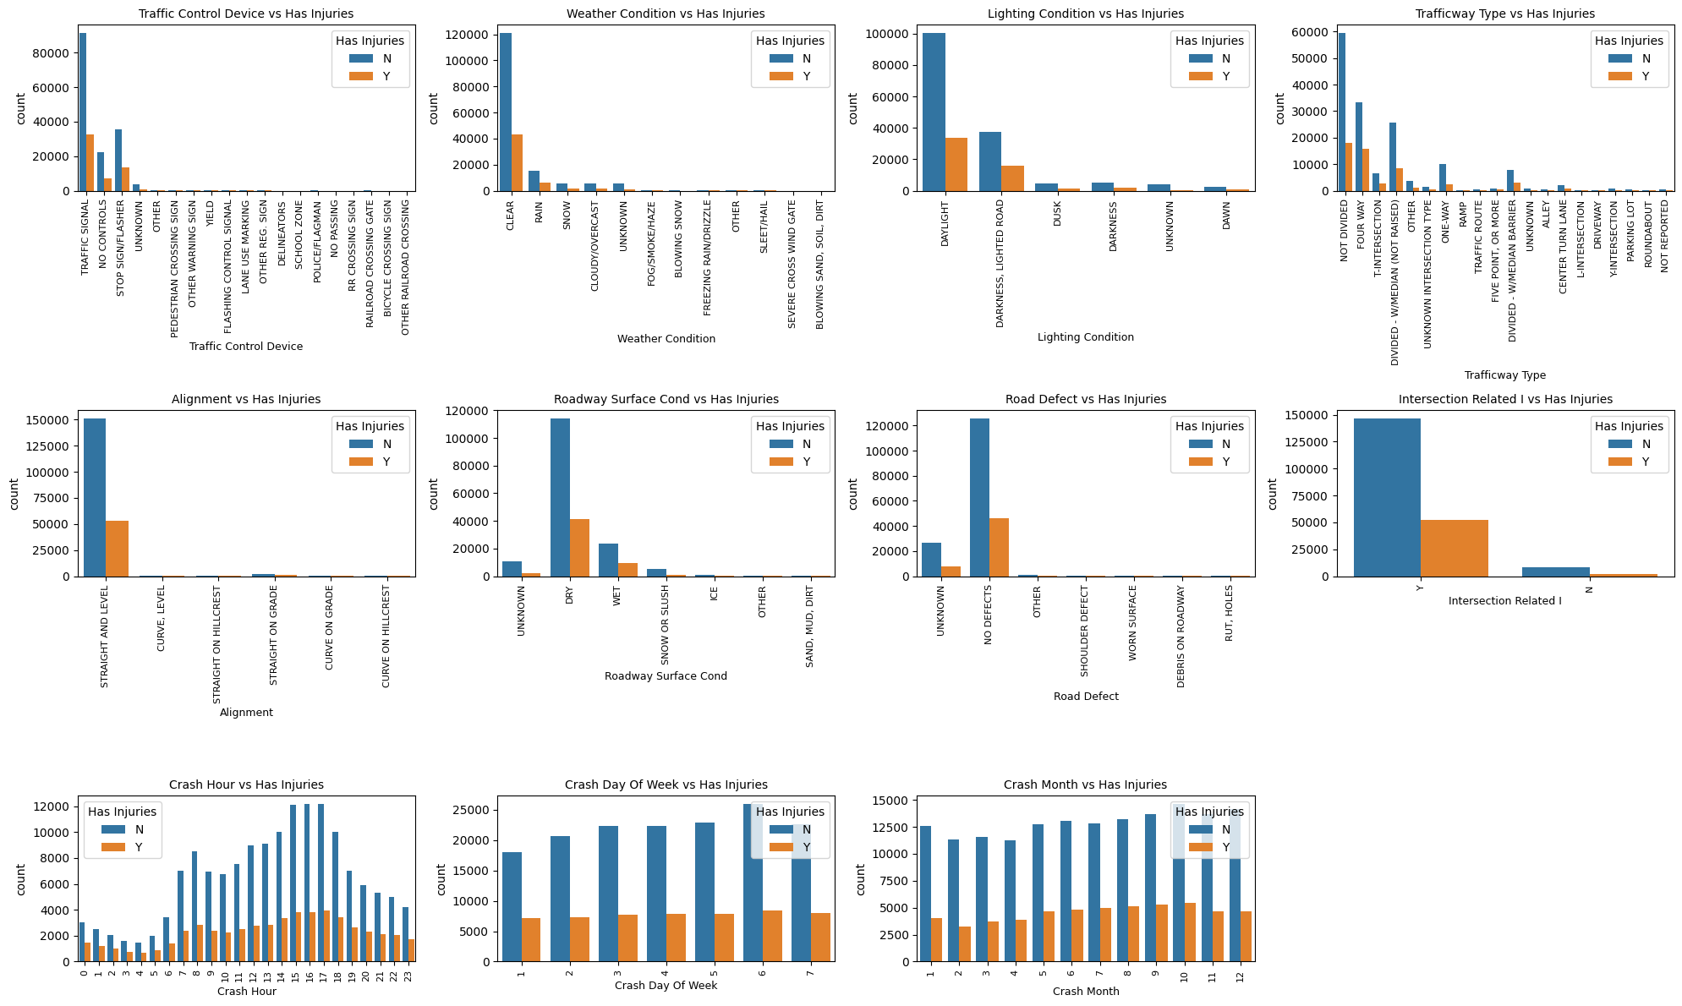

Slide 7



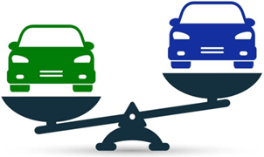
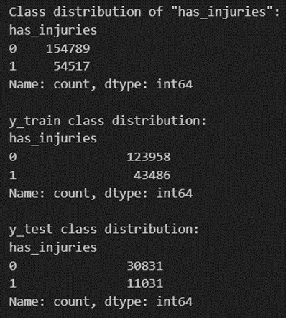
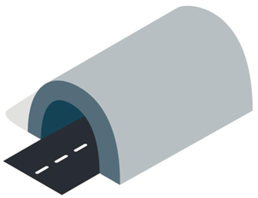
Data Preprocessing
Categorizing the data into 2 types:
1st - Cause (e.g. Weather, Road defect)
2nd - Consequence (e.g. Injuries, Fatal)
Split the dataset:
-Training: 80%
-Testing: 20%
Why:
-143 trillion combinations
-200k records only
Generalize 2nd type into 1 “Y” value:
⇒ “has_injuries” (1: yes ; 0: no)
Then, drop all other 2nd data type:
12 columns left
Resampling & Weight Balance
Transform all the 1st type data:
String → Integer

Slide 8

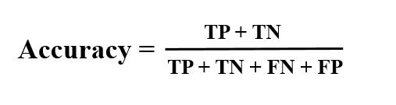
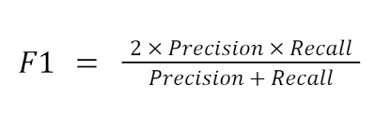
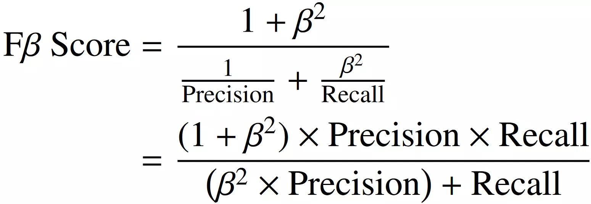
Metrics Used for Model Evaluation
Accuracy
  Measures overall correctness of predictions
F1 Score
  Examine the model’s ability to correctly identify
  both injury and no-injury cases
F2 Score
  How effectively the model identifies actual injury
  cases

Slide 9
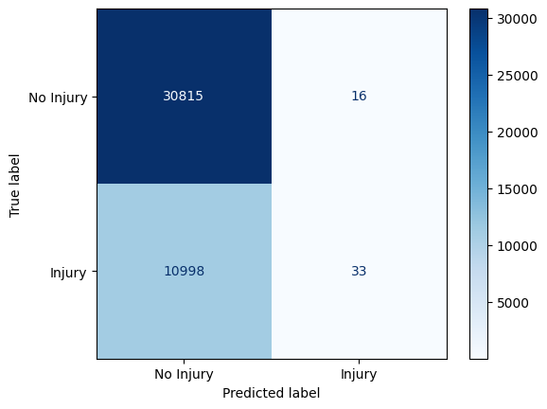
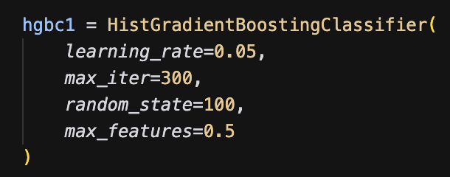
Model: Histogram-based Gradient Boosting Classification Tree
Mechanism
  handle large datasets with high performance
  Bins continuous features into discrete intervals
  Uses these bins to approximate split points, dramatically reducing computation
  Each tree tries to correct the errors of the previous one
Approach 1: train with the originally split data
  Accuracy: 73.69%
  F1 Score: 0.427, F2 Score: 0.00

Slide 10
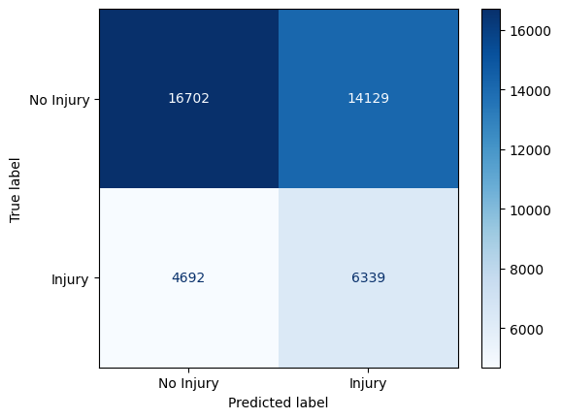
Model: Histogram-based Gradient Boosting Classification Tree
Approach 2: Hyperparameter tuning using Randomized Search
  Best Parameters: {'max_iter': 500, 'max_features': 1.0, 'max_depth': 7, 'learning_rate': 0.05, 'l2_regularization': 0.1}
  Accuracy: 73.66%
  F1 Score: 0.428, F2 Score: 0.00
  Minimal variation between approach 1 and 2
Approach 3: Train with resampled data
  Accuracy: 55.04%
  F1 Score: 0.521, F2: Score: 0.48

Slide 11
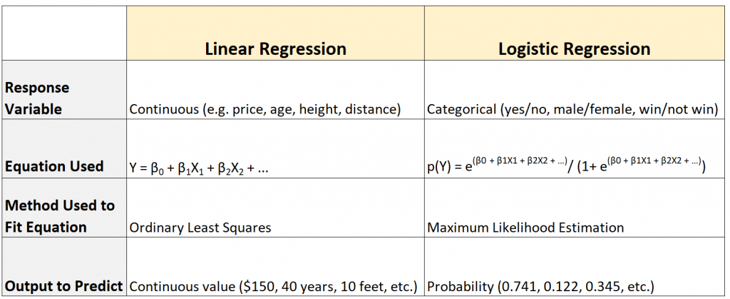
Model: Logistic Regression
Mechanism
supervised machine learning
for categorial problem
sigmoid function and log-odds concept
good at probability prediction
Rationale and Application
attributes of traffic accident for injury prediction
→ classification > clustering
→ categorical value (i.e. has or no injuries) > linear value
→ probability: maximum likelihood estimation
Future extension: binomial prediction (1 / 0) ⇒ ordinal prediction (low / mid / high risk)

Slide 12

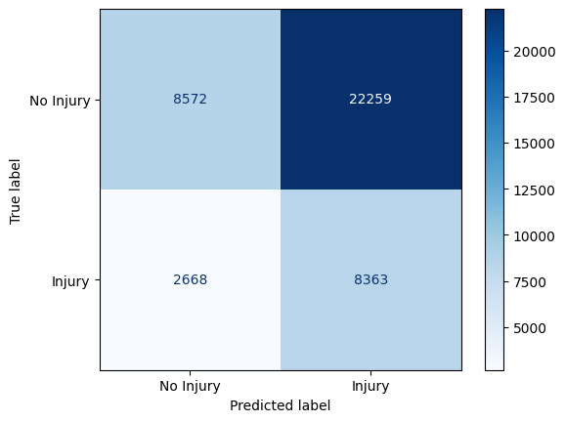
Model: Logistic Regression
Performance
Tuning: Randomized Search
Tuning: Bayesian Optimization
Unexpected Finding: the results after resampling / tuning are not “much” better; it may be even worse
Side Finding: there is NO Overfitting / Underfitting problem (as seen by use of “penalty” and “C” hyperparameter control of regularization strength) see ref.
Notes:
https://medium.com/@rithpansanga/logistic-regression-and-regularization-avoiding-overfitting-and-improving-generalization-e9afdcddd09d

Slide 13
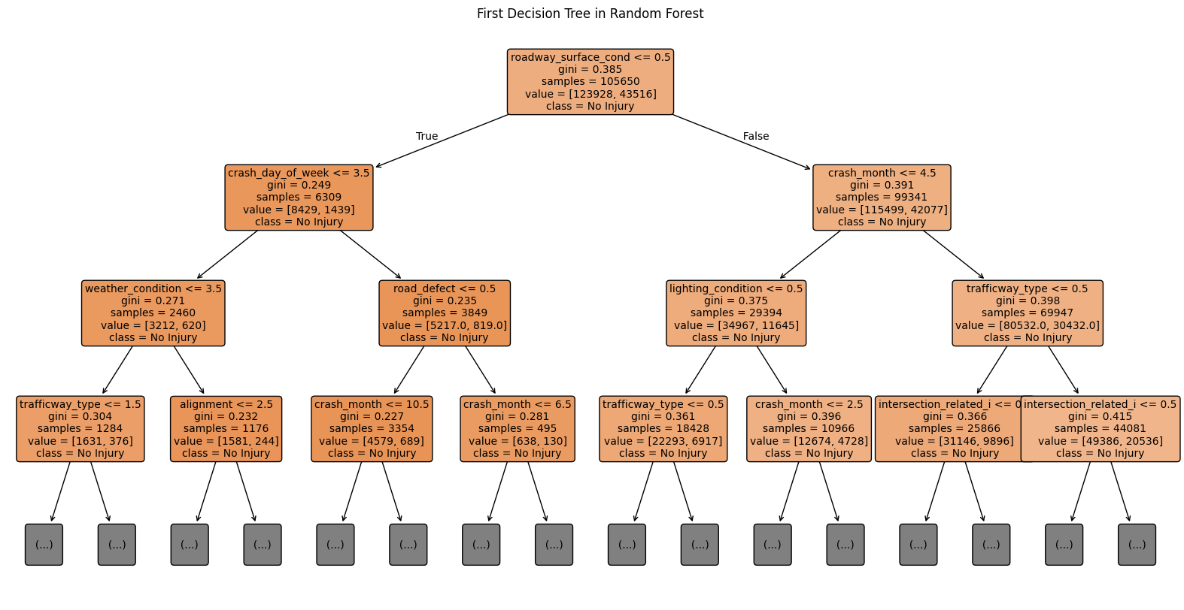
Model: Random Forest
Mechanism
Builds many decision trees using random data samples
Each tree uses random features for splitting nodes
Final prediction is based on majority vote from all trees
Advantages
Can handle multi-dimensional, mixed-type data
Reduces overfitting compared to a single decision tree
Works without needing complex data scaling or preprocessing, suitable for datasets with both categorical and numerical features

Slide 14
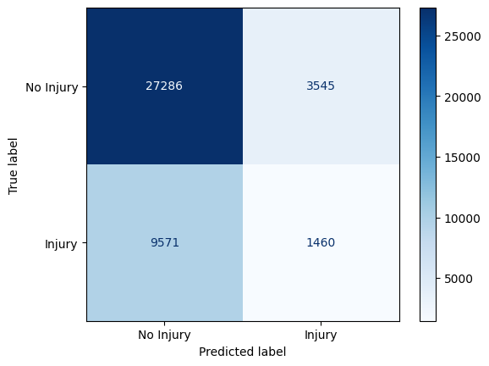
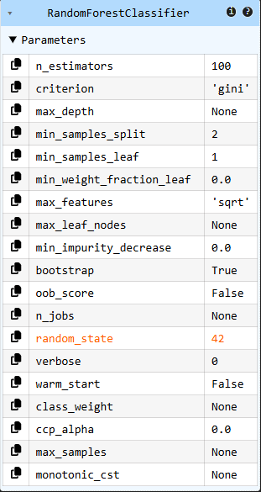
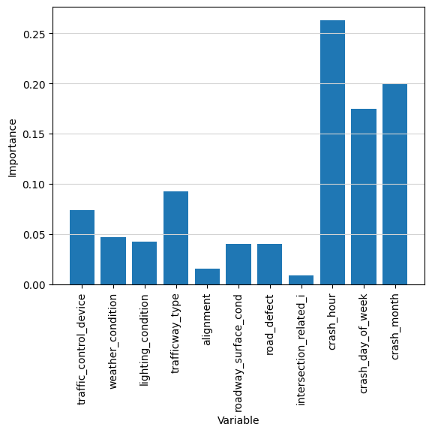
Model: Random Forest
Approach 1: Train with the originally split data
Performance
Random Forest Classifier Accuracy: 68.67%
F1 score : 0.49
F2 score: 0.15
Approach 2: Train new Random Forest with Selected Importance Features
- To reduce noise - helps avoid overfitting
Selected features: ['crash_hour', 'crash_month',
'crash_day_of_week', 'trafficway_type',
'traffic_control_device', 'weather_condition',
'lighting_condition', 'road_defect', 'roadway_surface_cond',
'alignment']
Performance
Accuracy after feature selection: 68.64%
F1 score after feature selection: 0.49
F2 score after feature selection: 0.15
No difference

Slide 15

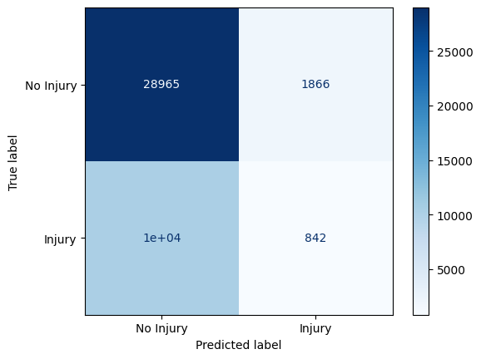
Model: Random Forest
Approach 3: Hyperparameter tuning using Randomized Search
Performance
Accuracy after Randomized Search: 73.64%
F1 score after Randomized Search: 0.42
F2 score after Randomized Search: 0.15
Accuracy increase from 68.67% to 73.64%, but F1 score decrease from 0.49 to 0.42
Further tuning:
Validate Random Forest hyperparameter tuning using Cross-validation with F1 score as the scoring metric in Randomized Search
- To ensure stable, balanced estimation - To reduce overfitting risk
Performance
Best cross-validated F1 score: 0.48
Test accuracy after cross-validation: 71.20%
Test F1 score after cross-validation: 0.48
Test F2 score after cross-validation: 0.49
F1 score increase from 0.42 to 0.48

Slide 16
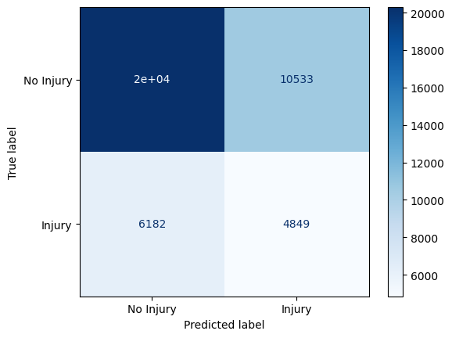
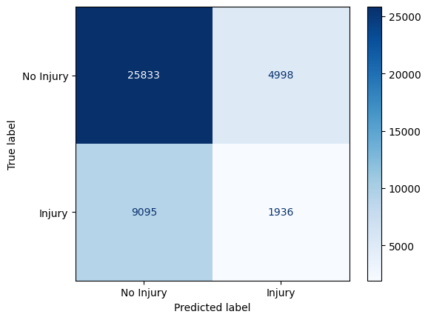
Model: Random Forest
Approach 3: Hyperparameter tuning using Randomized Search
Further tuning:
Initialize model again with class_weight balanced
to prevent class imbalanced
Performance
Accuracy with class_weight balanced: 60.07%
F1 score with class_weight balanced : 0.54
F2 Score with class_weight balanced: 0.54
The highest F1 & F2 score: 0.54
Reducing bias towards majority classes
Approach 4: Tuning with Bayesian Optimization
Performance
Test Accuracy with Bayesian Optimization: 66.33%
Test F1 Score with Bayesian Optimization: 0.50
Test F2 Score with Bayesian Optimization: 0.50
Higher accuracy with high F2 & F2 score
Achieve better tuning results more quickly on imbalanced datasets

Slide 17
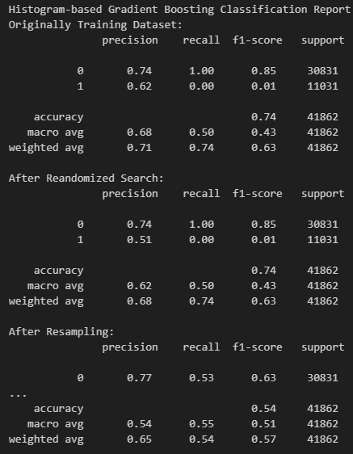
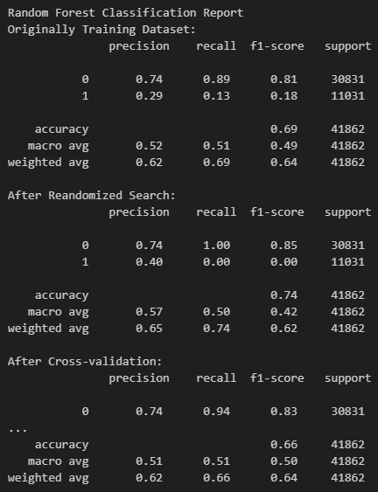
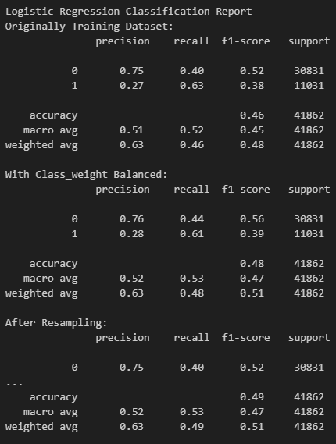
Comparison
Classification Report

Slide 18
Comparison
Model | Methods | Accuracy | F1 Score | F2 Score
1. Histogram-based Gradient Boosting Classification Tree | Originally training dataset | 73.65% | 0.43 | 0.00
 | Randomized search | 73.66% | 0.43 | 0.00
 | Resampling | 53.92% | 0.51 | 0.48
2. Logistic Regression | Originally training data | 73.65% | 0.42 | 0.00
 | Randomized search | 48.69% | 0.47 | 0.50
 | Bayesian Optimization | 74.03% | / | /
3. Random Forest | Originally training dataset | 68.67% | 0.49 | 0.15
 | Randomized search | 73.64% | 0.42 | 0.50
 | Cross-validation | 71.20% | 0.48 | 0.49
 | With class_weight balanced | 60.7% | 0.54 | 0.54
 | Bayesian Optimization | 66.33% | 0.50 | 0.50

Slide 19
Challenges and Limitations
Challenges and Limitations | Future Improvements
Class imbalance in test set | Better way of resampling Further refine the models (e.g. use precision-recall Curve to maximize the recall)
Noisy features (e.g. alignment, intersection_related_i) hinders the performance | Deeper EDA and revisit the feature importance of each attributes for future preprocessing
Too vague to only output 0 (no injuries) and 1 (has injury) | Turn to ordinal prediction (high / mid / low risk), or even a generated probability
Too general for “has_injuries” only | Break down to mild, incapacitating, fatal injuries prediction

Slide 20
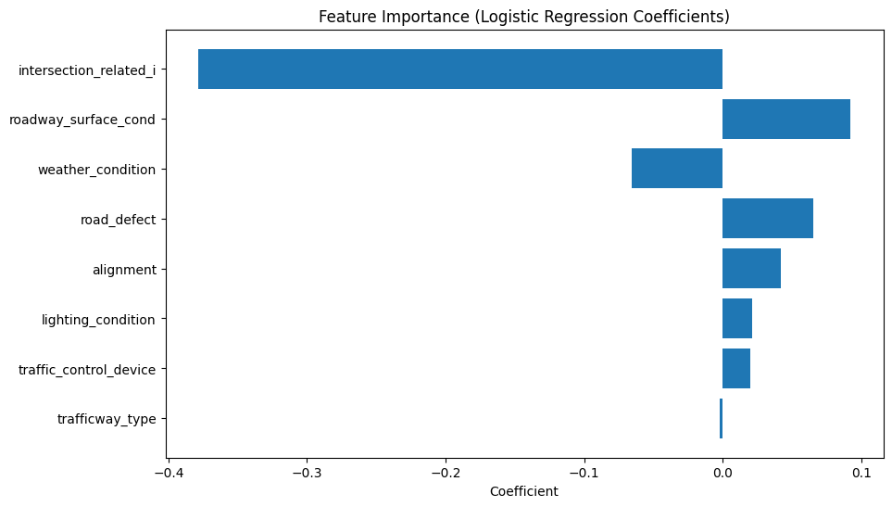
Demonstration
Be practical; let the machine learning jump out of machine.
Real world application: analyze and assess the risk of injurable traffic accident under certain road conditions
Traceable and Explanatory (audit trail in commercial world)

Slide 21
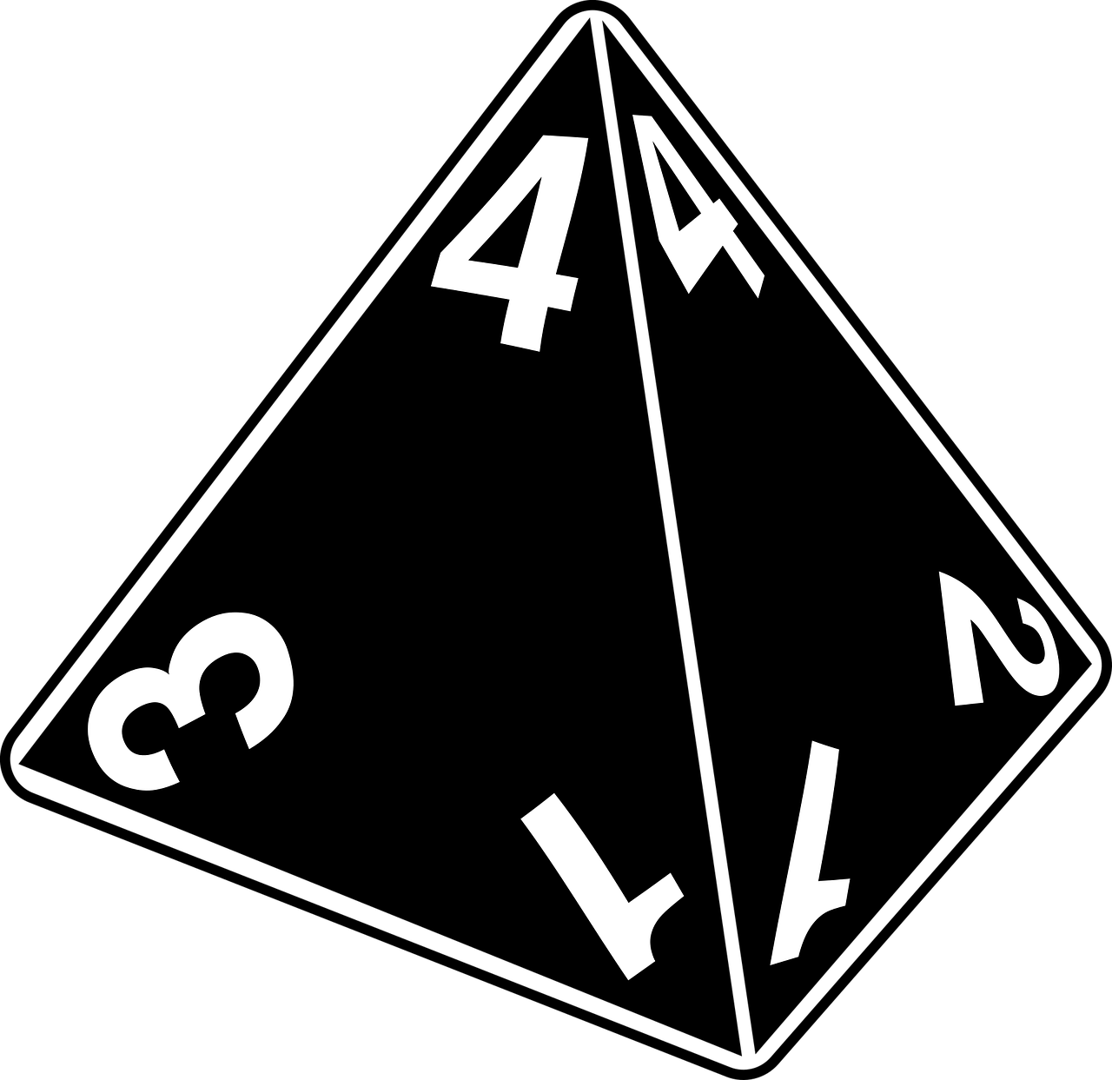
Conclusion
Similar performance for all 3 models
No obvious overfitting / underfitting problem
No “significant” improvement though Hyperparameter Tuning
Sampling imbalance (1:3) in nature as the biggest challenge
But a nearly 75% true prediction is encouraging
Insight: Machine can never be human
Machine learns from logic (classification / clustering) and calculation
→ all in “no injuries”
Human interprets meaning behind with sense of secure and fear to risk
→ prefer warning of “injury” risk

Slide 22
Reference
https://www.kaggle.com/datasets/oktayrdeki/traffic-accidents
https://medium.com/@rithpansanga/logistic-regression-and-regularization-avoiding-overfitting-and-improving-generalization-e9afdcddd09d

